Slide 1

2023 AIST4010
Style Transfer:
from pix2pix to CocosNet
SHI Juluan SID:1155160208
Computer Science

Slide 2
AlexNet(2012): CNNs have become a dominant model for various
computer vision tasks.
Image style transfer: a distinct challenge.
Project objective: dive into history of style transfer; re-implement pix2pix and cycleGAN and apply them to generate comic-style faces.
CocosNet: a more advanced model in image-to-image translation field.

Slide 3
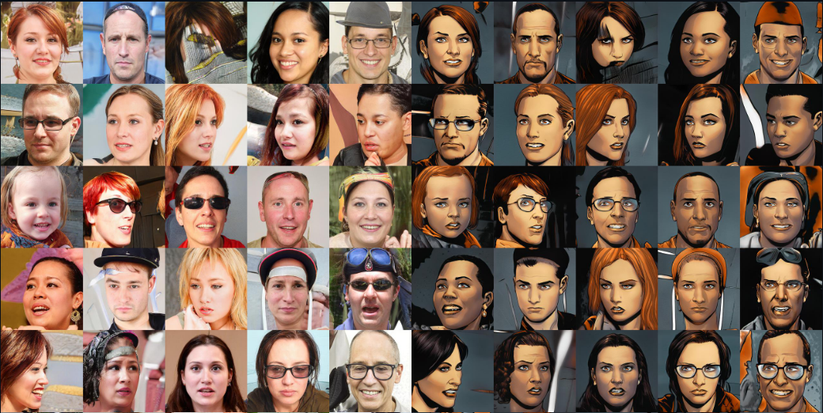
Dataset
Have you ever imagined how you look like in a comic style？
10,000 pairs of facial and darkish red style comic images.
1024*1024 resolution

Slide 4
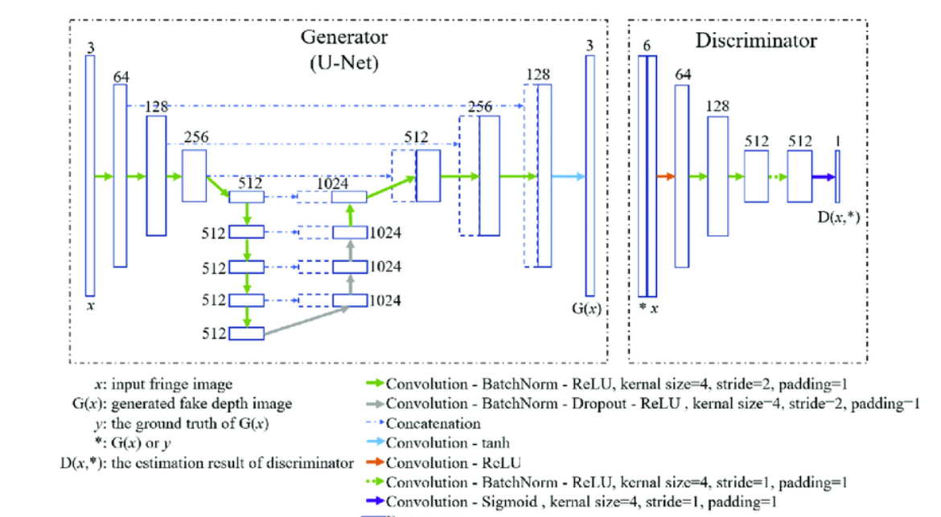
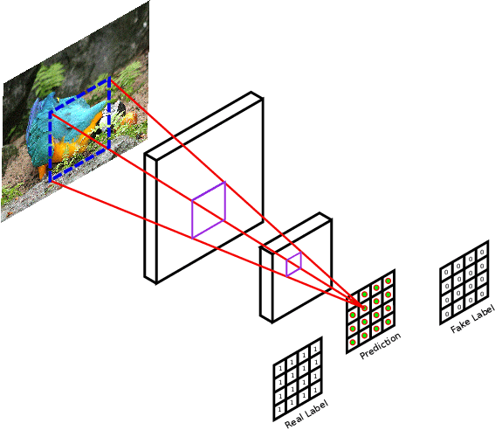
pix2pix
patchGAN

Slide 5
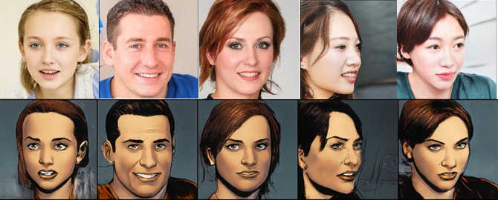
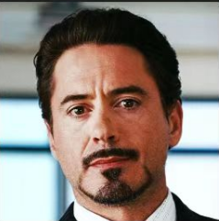
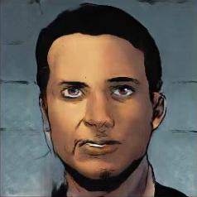
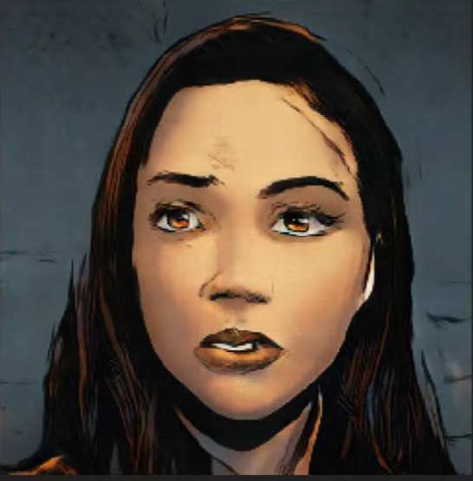

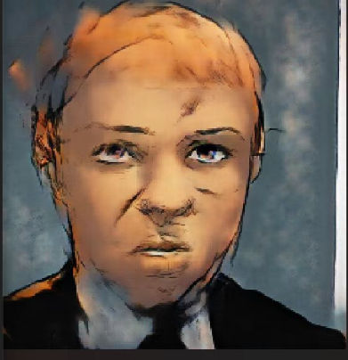
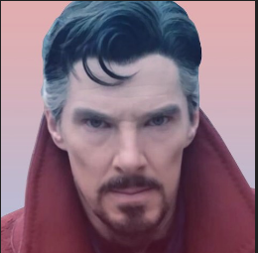
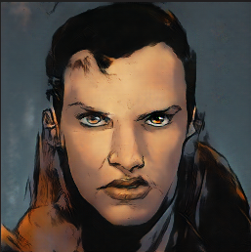
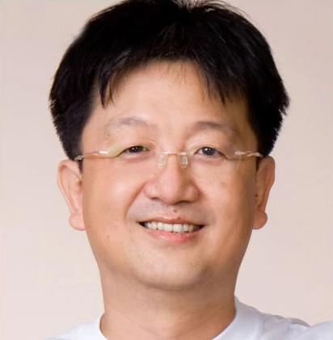
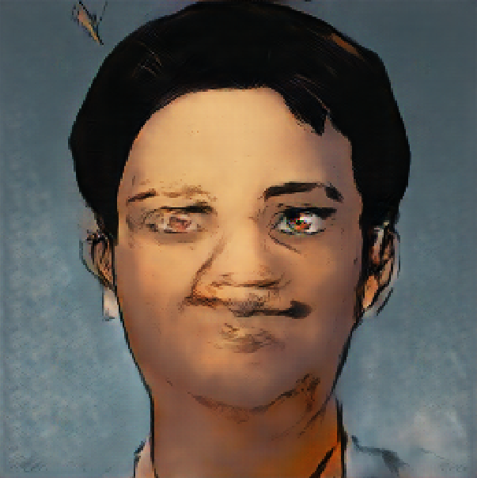
Results of pix2pix
It lacks robustness when tested with images sourced from the internet !

Slide 6
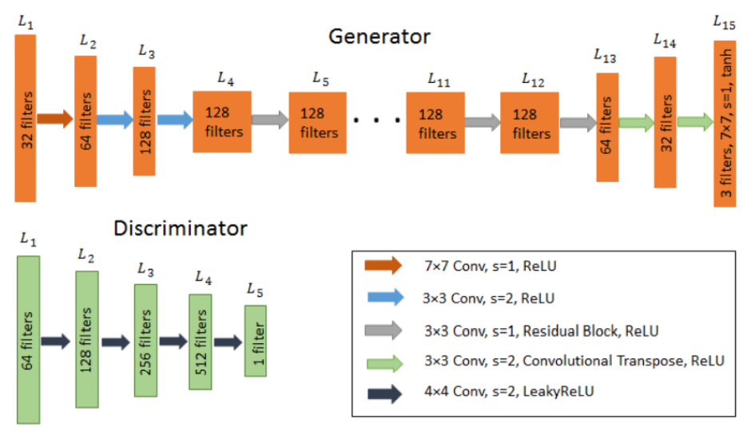
CycleGAN

Slide 7
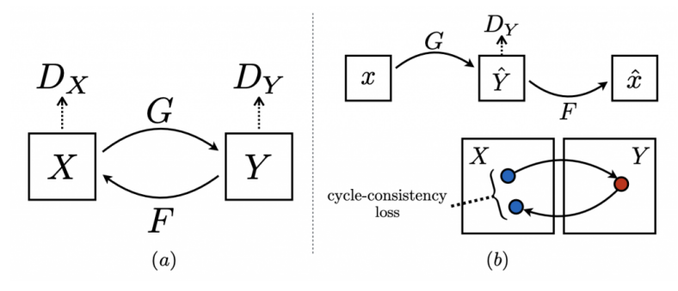
Cycle Consistency Loss
PPT下载 http://www.1ppt.com/xiazai/

Slide 8
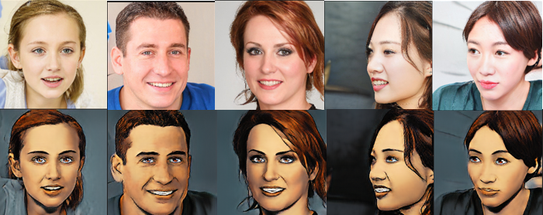
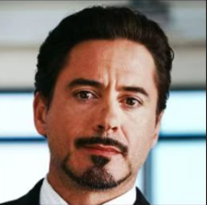
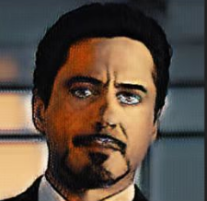
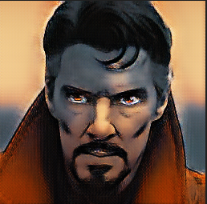
Results of CycleGAN
Not enough geometric changes! It can only change the texture and style of the input images!

Slide 9
Limitations of pix2pix and cycleGAN
pix2pix model lacks robustness
Hyperparameter tuning
Replace U-Net with more a advanced generator
Use pretrained VGG-19 to supervise the output in different levels
cycleGAN model fails to perform geometric changes
Hyperparameter tuning
Add two traditional discriminator to evaluate the shape of the output images

Slide 10

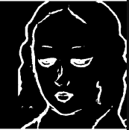
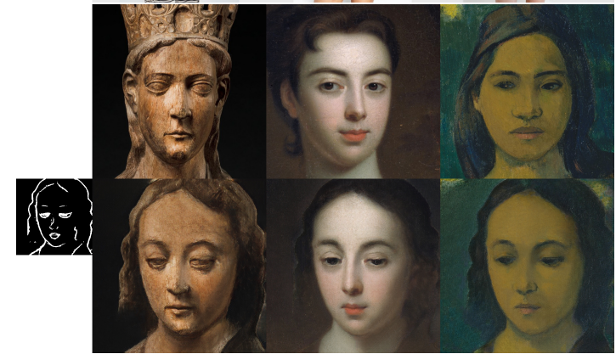
Exemplar-based Image translation

Slide 11
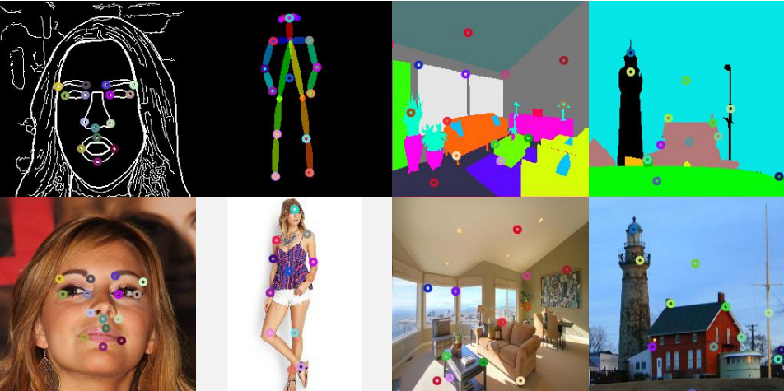
Correspondence

Slide 12
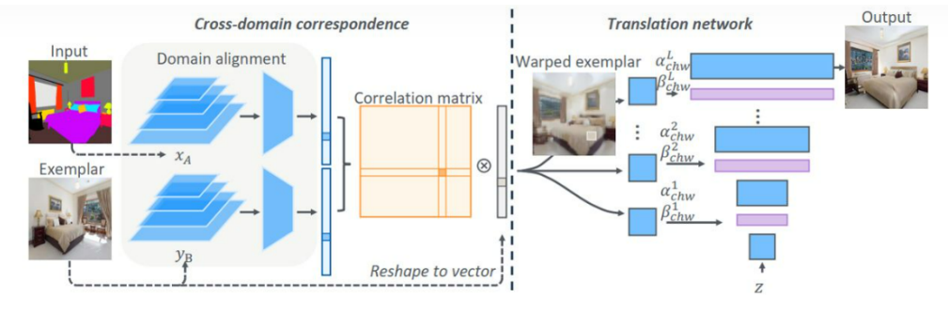
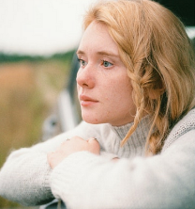
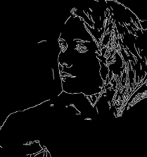
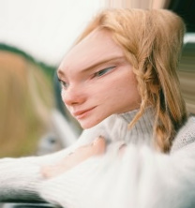
CocosNet

Slide 13
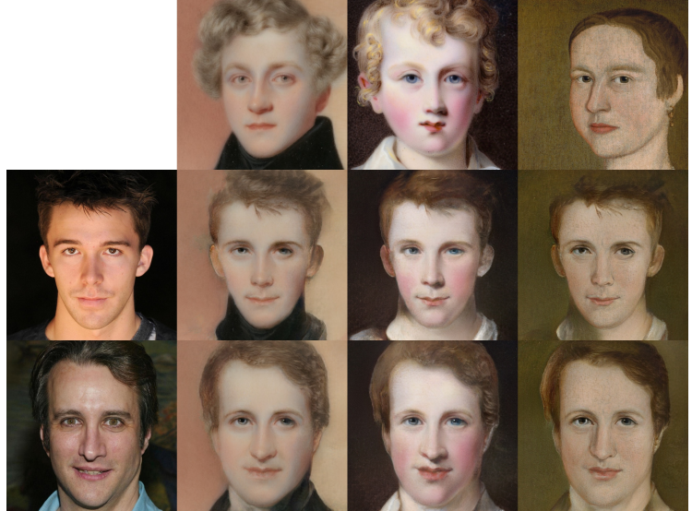
CocosNet v2

Slide 14

THANK YOU

